Slide 1



Environmental effects on Spatially-resolved Star Formation and Interstellar Medium Properties in the Virgo Cluster
Rongjun Huang
Supervisors: Luca Cortese, Luke Davies

Slide 2
Outline
Background
This Work

Slide 3
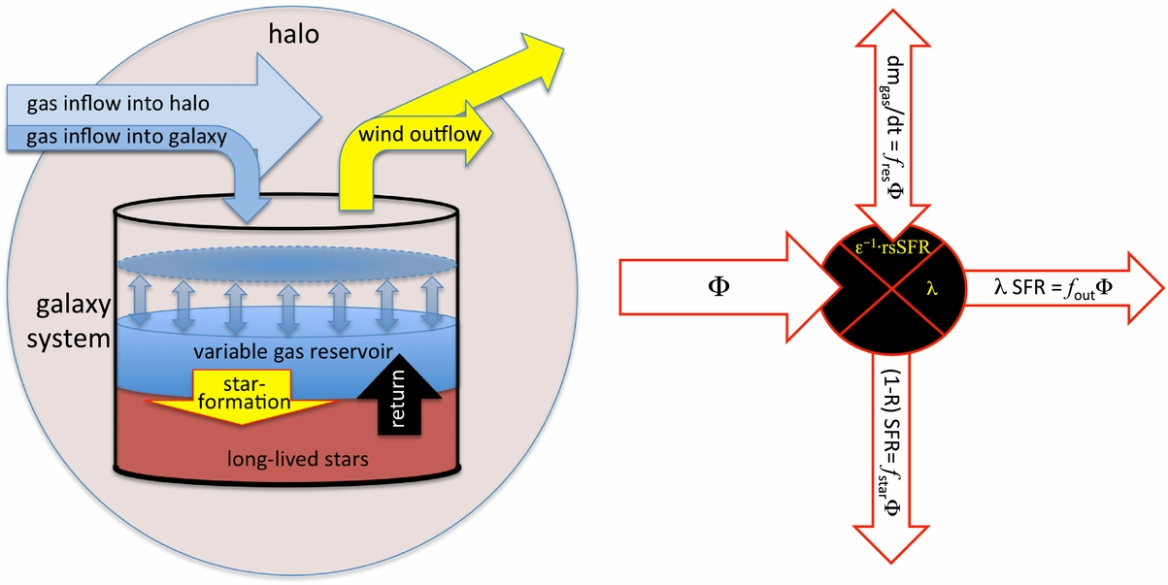
1. Background. Self-regulation (“Bathtub”) model
Gas inflow from the IGM fuels star formation; feedback-driven outflows expel gas.
Gas reservoir adjusts quickly: system tends toward equilibrium where SFR balances net accretion.
(Lilly+2013)
Bathtub model => Predicts key scaling relations

Slide 4
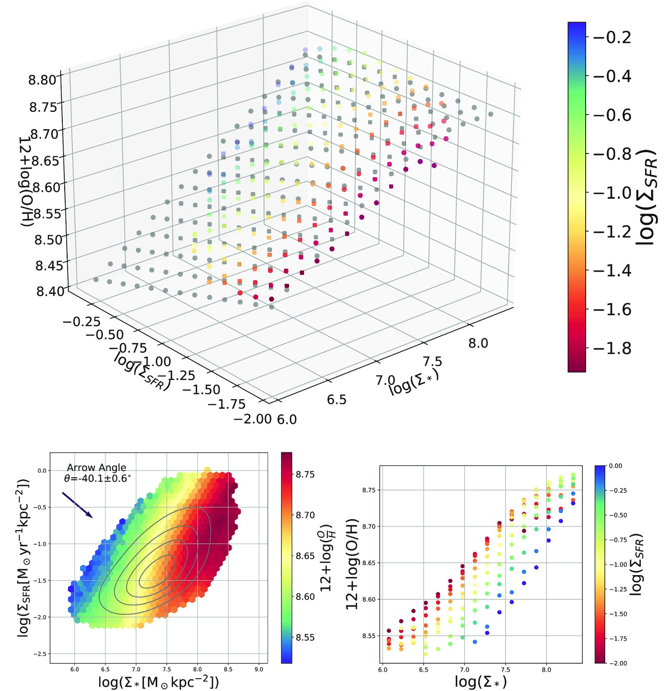
1. Background. Scaling relations (Spatially-resolved)
rSFMS
rMZR
rFMR
(Baker+2023)

Slide 5
1. Background. From field to cluster galaxies
\item \textbf{SFMS/rSFMS:} similar slope, \textit{larger scatter} in clusters due to quenching (e.g. \ion{H}{i}-stripped spirals below sequence).
\item \textbf{Metallicity:} modest \(\sim\)0.05 dex enhancements at fixed mass in satellites vs. field.
\item \textbf{Physics:} ram-pressure stripping (RPS), starvation/strangulation, tidal interactions
\item \textbf{Implication:} galaxies can deviate from the FMR depending on recent inflow/outflow history.

Slide 6
1. Background. Scientific Motivation (Virgo Cluster)
\item Clusters are stress-tests of self-regulation: do equilibrium relations survive at \(\sim100\) pc scales?
\item Virgo (\(D\!\approx\!16.5\) Mpc) is close enough to resolve individual \ion{H}{ii} regions and spans diverse infall stages.
\item We seek to \textbf{map and compare} the resolved metallicity surface \(\Zgas(\SigST,\SigSFR)\) across environments.

Slide 7
2. This work. Objectives (PhD Program)

